Slide 1
Bank Telemarketing outcomes
Selina Matthews, Shaun Xu, Haodong Zhang

Slide 2
Outline
Introduction
Project specifics
Conclusion

Slide 3
INTRODUCTION
Our project looks at the efficacy of a direct marketing campaign by a Portuguese bank
According to a report issued by Deloitte in 2019, the increase in the use of AI and machine learning in marketing increased by 27% from 2018 to the time of the report.
This is also predicted to increase steadily over the coming years

Slide 4
The dataset
Our dataset featured over 4100 rows of original data on 21 aspects of the target clients
We then increased the number of rows to over 41 000 in order to increase the accuracy
Attempting to find whether the direct marketing technique worked on the clients, with an outcome of either accepting or rejecting the long-term deposit

Slide 5
Libraries used
SQLite
Used to house our data, as we have more familiarity with it
Scikit-Learn
Used to split our data into a test and training set, as well as fitting and scaling our data
Pandas
We used this to process and clean our data
Used Keras to create a neural network
Tensorflow
Tableau
Used to display the results of our activation functions and accuracies

Slide 6
Steps
Cleaning and processing
After importing dependencies, we dropped any null values and found the number of unique values in each column. We then converted everything to numerical data.
Splitting and scaling
We then split the preprocessed data into the standard x_train/x_test and y_train/y_test, fit it and scaled it using standard scaler
Defining the model
Used Keras to create a deep neural net and used ReLU, Tanh and Sigmoid functions on the layers. The model was then ready to be compiled and fit
Evaluating the model
Using the test data, we evaluated the model and ended up with a loss of 0.2335 and with accuracy of 0.9029

Slide 7
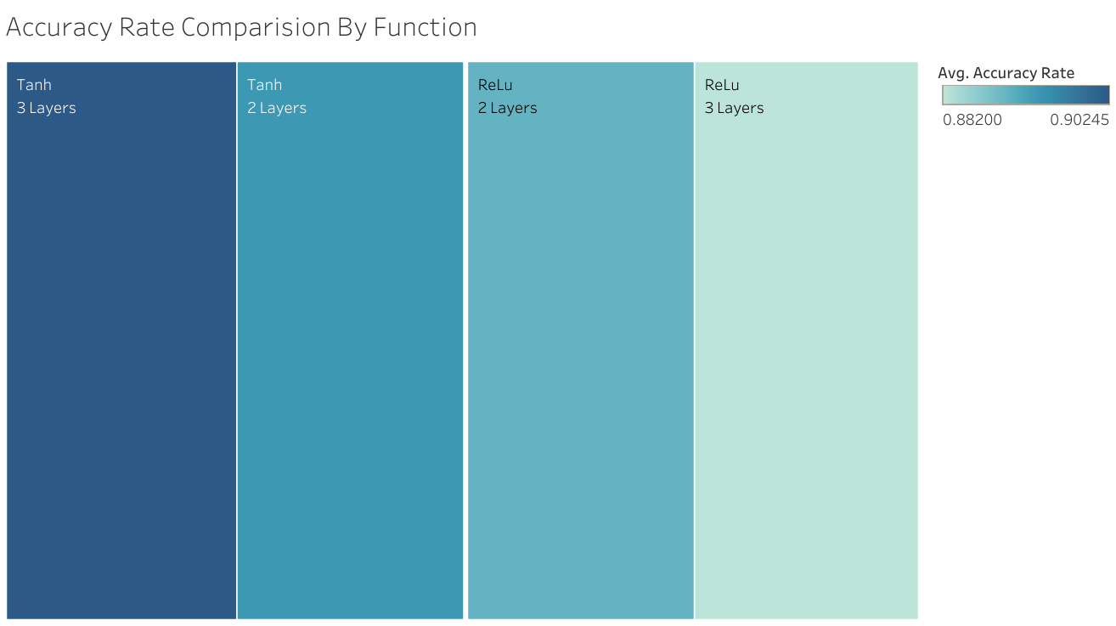
Accuracy rate by function
Highest accuracy rate at 0.9025 achieved from the Tanh function with 3 layers
Lowest accuracy was using the ReLu function with 3 layers
This conclusion comes from our optimization process, in which we found that we got the best results using a Tanh function, with 3 hidden layers rather than 2
After some trial and error, our most accurate result was Tanh with a 3/6/12 layer

Slide 8
Limitations
Potentially outdated
Time
Different consumer market
Dataset is based on a specific offer of a long-term deposit
Data is from one specific bank and may not reflect other markets
Data was collected from 2008 to 2013, and may not be applicable to current markets
Use case may not be relevant today, but it does show the potential for this type of model when based on updated data​​​
The project itself was scaled back in terms of scope dramatically, as previous datasets we had hoped to use were not suitable for our project
We would have liked to do more with the data and create a more interactive experience with it.

Slide 9
Shill bidding
What is it?
Issues with the dataset
Also referred to as dummy bidding
Used to make an item seem more popular that it is, encouraging others to also bid on it, as well as to drive up prices of items
One of the most prevalent forms of fraud on eBay, against the terms of service
Dataset was believed to be a real dataset
After running our model on it, the accuracy was over 99%, leading us to believe it was a dataset designed to help people learn machine learning and, thus, unsuitable for our project

Slide 10
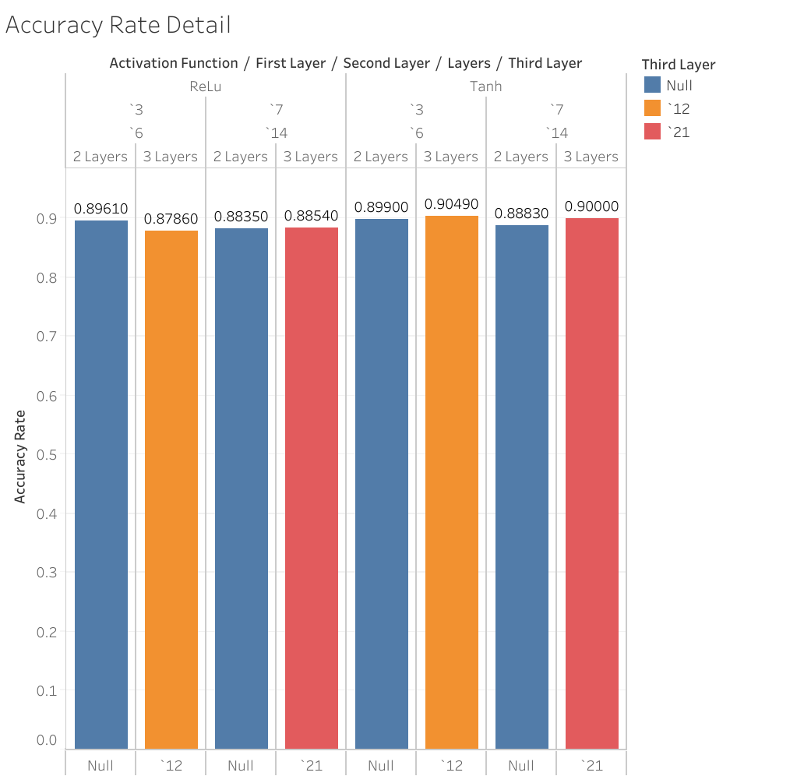
In conclusion:
Right:
A breakdown of the various layers and their respective functions with their accuracies
Machine Learning is already being used in commercial settings - marketing is one of them, which shows a strong indication of growth over the next few years
For our particular project, the accuracy is quite high for predicting whether or not a potential client would accept a long-term deposit across the board
It was unexpected that our dataset would be more accurate using Tanh function over ReLu, but it goes to show that different functions still have their uses, despite ReLu being considered the most useful for machine learning
The optimized (41,188 rows data set) accuracy will increase to 0.9159

Slide 11
THANK YOU
Data and Sources:
https://archive.ics.uci.edu/ml/datasets/Bank+Marketing
A data-driven approach to predict the success of bank telemarketing
https://libkey.io/libraries/591/articles/49822781/full-text-file?utm_source=api_309
https://www2.deloitte.com/content/dam/Deloitte/us/Documents/CMO/us-the-cmo-survey-fall-2019.pdf

